Slide 1
Online Examination System
by- Monu Kumar

Slide 2

Government Polytechnic Munger
Online Examination System
Minor Project Synopsis
Submitted To
Department of Computer Science & Engineering
Government Polytechnic Munger
Session 2018-2021
Submitted By :- Head of Department Under the Guidance of :-
Monu Kumar Mr. Paritosh Kumar 1. Mr. Mukesh Gupta Sir
Roll no.- 04/CSE/18 2. Mr. Bikey Kumar Sir

Slide 3
Contents
Why online examination
Software & Hardware requirement
Module
Advantage & Disadvantage
Conclusion
Reference

Slide 4
Why Online Examination
Flexible
Time Saver
Auto Grading
Security
General problem with time for student

Slide 5
Software Requirement
XAMPP Server
Google Chrome
Visual Studio Code
Notepad++

Slide 6
Hardware Requirement
Chipset: ARM Based.
Memory: 128MB RAM 256MB Flash External.
Storage: Mini or Micro SD Card.
Primary Display: QVGA TFT LCD or large,16 Bit colour or Better.
Mouse.
Keyboard.
Processor: Pentium Processor and above.

Slide 7
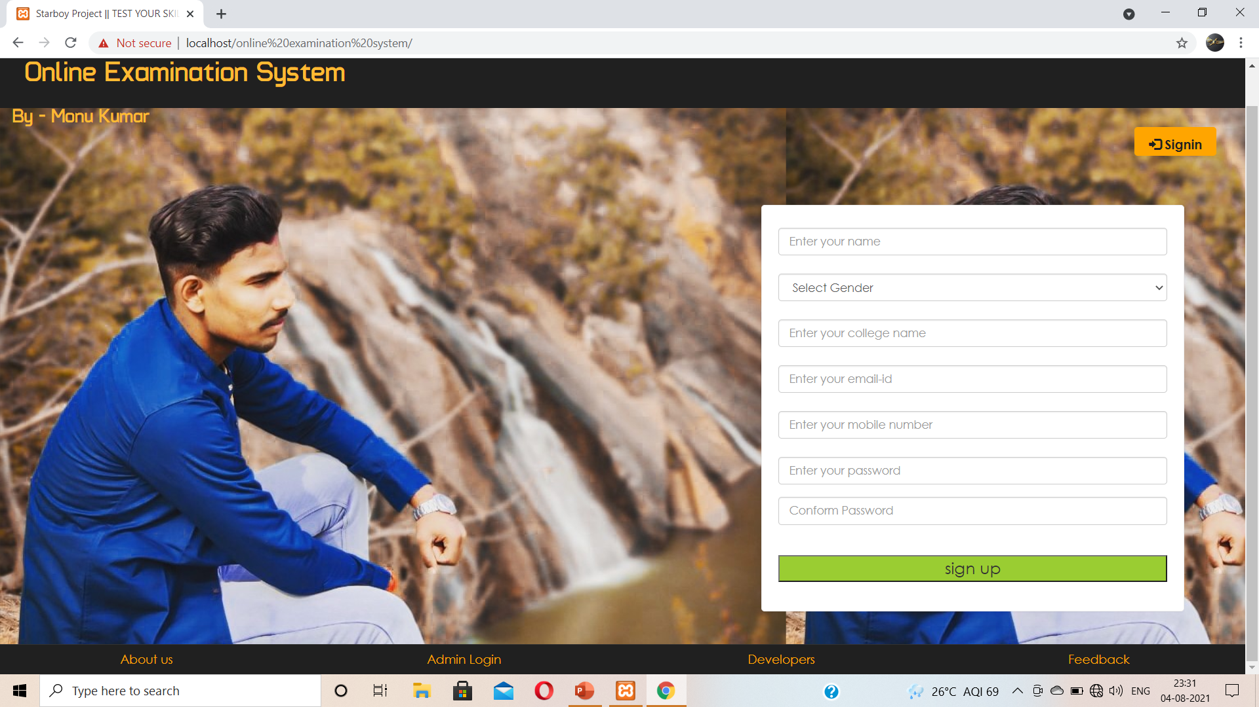
Module

Slide 8
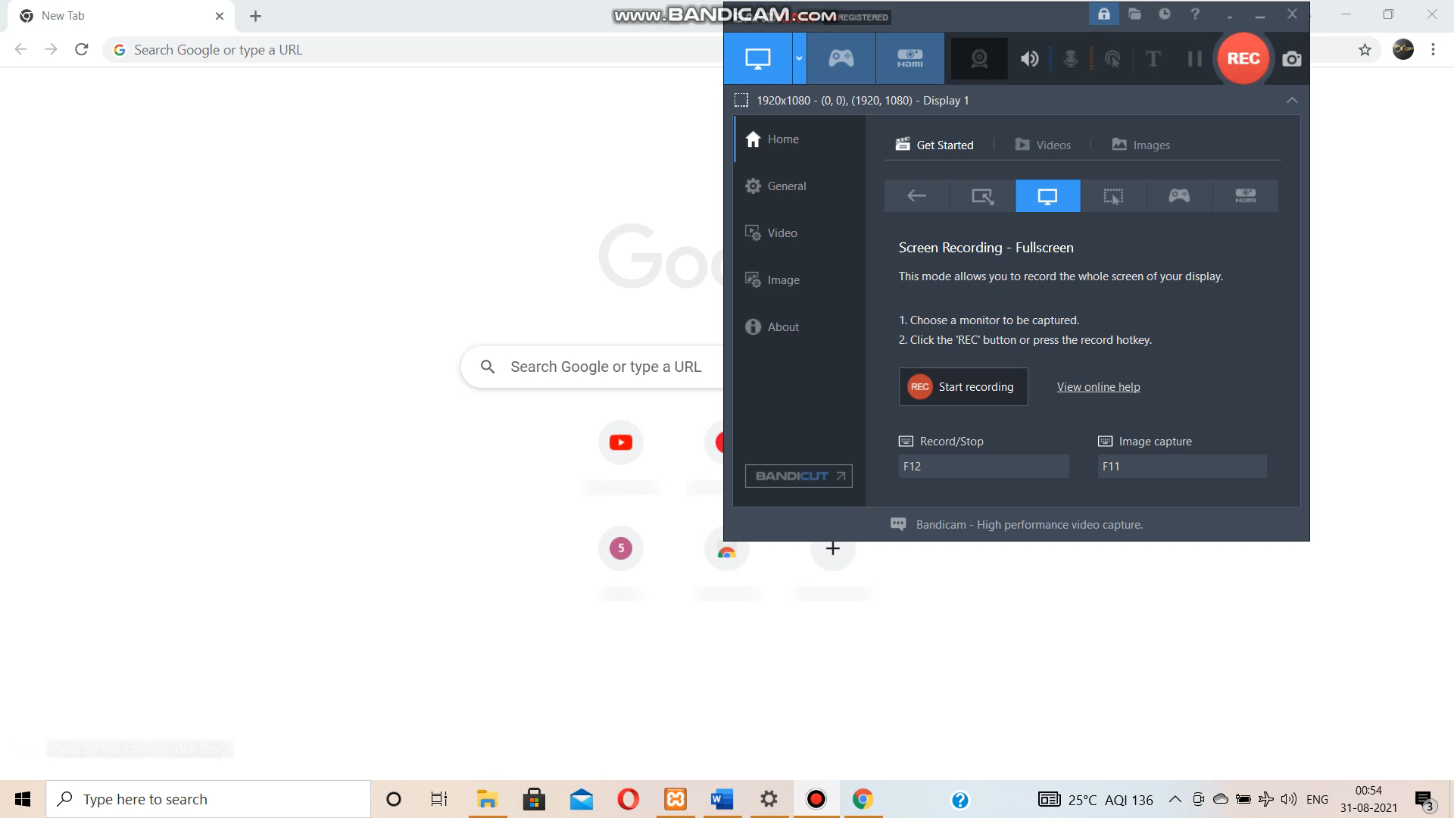

Slide 9
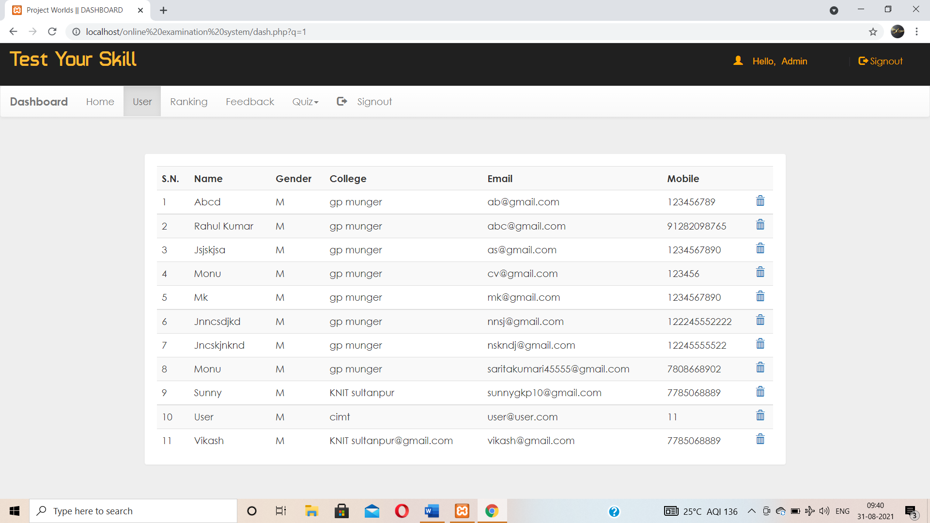

Slide 10
Advantage & Disadvantage
Advantage
Accuracy in checking the answer , calculating result.
Can be easily accessed 24/7 over the open test period.
Disadvantage
Requires Stable Internet Connection
Requires A Device

Slide 11
Conclusion
The Web Application provides facility to conduct online examination worldwide. It saves time as it allow number of students to give the exam at a time and displays the results as the test gets over, so no need to wait for the result. It is automatically generated by the server.
Administrator has to create, modify and delete the test papers and its particular question. User can sign up and give the test with his specific id, and can see the results as well.

Slide 12
Reference:
Complete Reference of PHP
https://www.wikipedia.org/
https://www.youtube.com/

Slide 13
Thank You

